Slide 1


Inclusion and Accessibility: Start right now!
Dennie Declercq
Lightning Talks // .NET Oxford @DennieDeclercq #DreamingIsBelieving

Slide 2
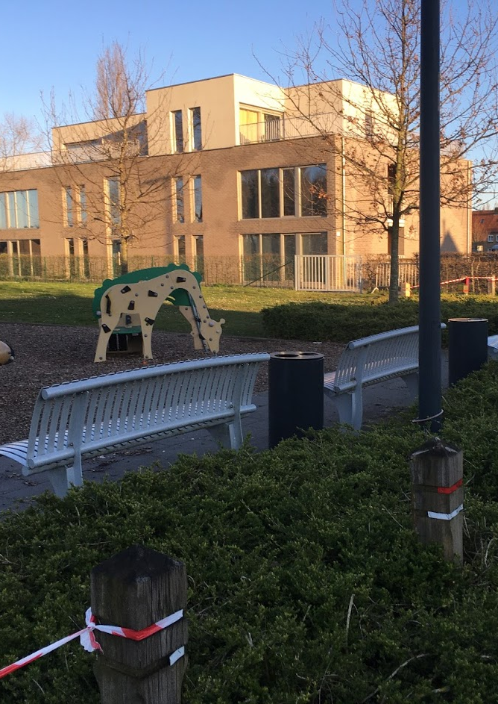
Inclusion and me
Ithaka
Accessible Software
De Bezaan
Autism

Slide 3
Did you ever think about?
There are people with:
Autism / Aspergers / ASD
Learning Disabilities
ADHD
Anxiety
AND
Vision loss
Hearing difficulties
Elderly

Slide 4
Intro to QOL
Quality
Life
Health
Money
Interdependency
Freedom
Choices
Meaningfulness
“Feeling good”
Work
Free time
School
Transport
Food
Sports
Hobby
Transport

Slide 5
What are Accessible Apps?
Apps to assist
Apps to help
Apps that can be used
Apps that are structured
Apps with the right color scheme
Apps With the right size
Apps ordered by function
Apps that are error less
Apps with the right word use
Apps with Text To Speech
Apps with Images and pictograms
Apps that are robust

Slide 6
Apps vs Websites
Websites
Apps
WCAG
Screenreaders
Autism Friendly Label
Official scores
NO official standards
Text To Speech
Mobile – Driven - World
Mobile on demand
Cloud opportunities
Missing link

Slide 7
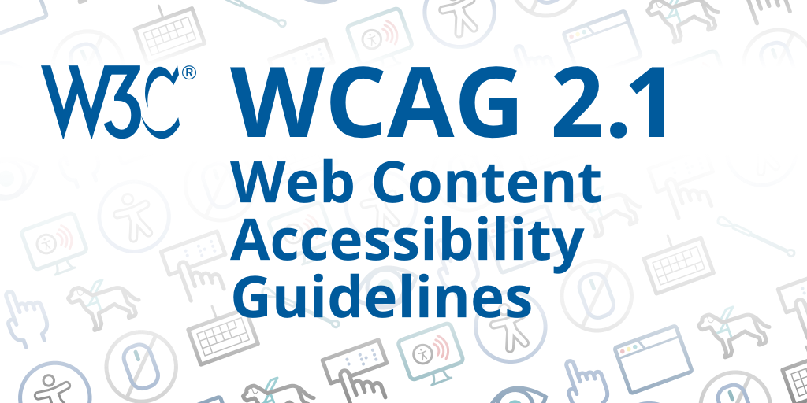
WCAG
Principles
Missing
Perceivable
Operable
Understandable
Robust
Learning disabilities / ASD / ADHD
Mobile
Hope for WCAG 2.2? WCAG 2.x? WCAG 3?

Slide 8

Start right now!
Learn about accessible app development
Learn about inclusive apps
Look in your own surroundings:
What are you doing in:
Daily life
Hobbies?
Do you see PWD?
Heard about PWD?
Look at governmental apps
Can YOU make the difference?

Slide 9
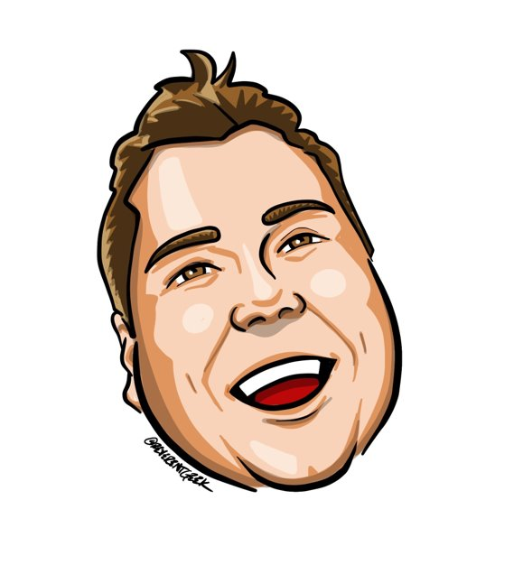


Thank
Dennie Declercq
Dennie@ddsoft.be
@DennieDeclercq
#DreamingIsBelieving
PROUDLY SPONSORED BY:

